Slide 1
Capstone Project
[ABTN0104]
Team 3 : IPL T20 Cricket Analysis
Individual Member
Kota lakshmanarao

Slide 2
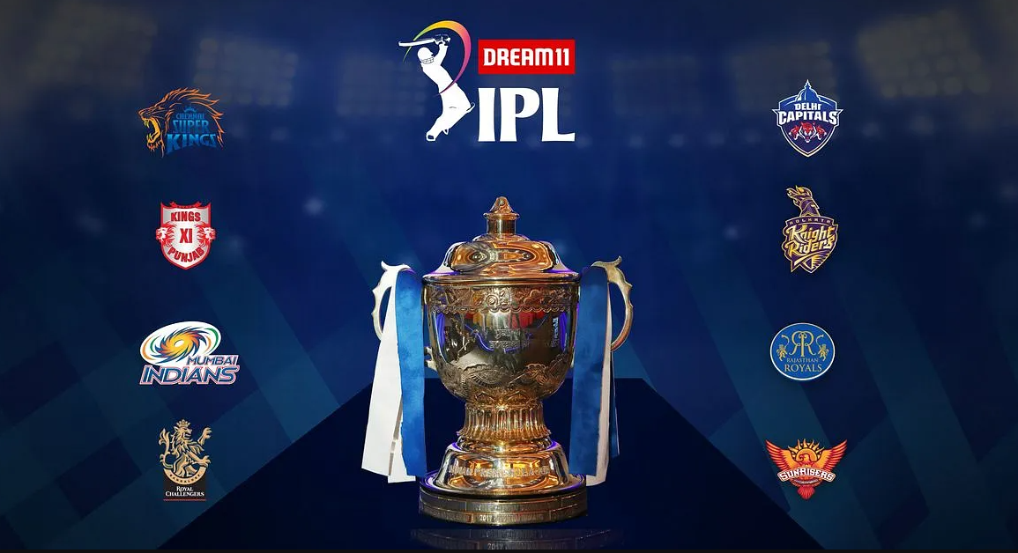
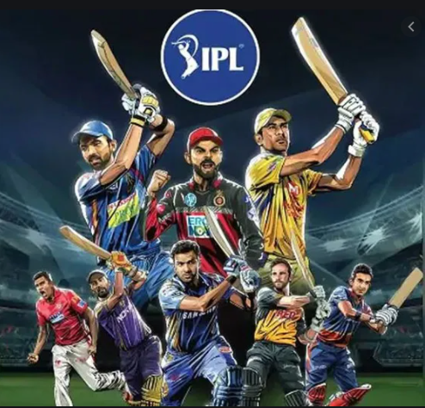

Slide 3
Content
Problem statement
Data summary
Covering insights from the EDA
Challenges
Conclusions

Slide 4
Problem Statement
Indian Premier League(IPL) is a professional Twenty20 cricket league in India contested during March or April and May of every year by eight teams representing eight different cities in India. The league was founded by the Board of Control for Cricket in India(BCCI) in 2008.
Explore and analyze the data to discover the insights.

Slide 5
Data Summary
We have two major datasets (2008 to 2019) available with us to perform EDA:
Deliveries.csv
This dataset contains ball by ball records of each match of each season.
Matches.csv
This dataset contains records of each match each season.
For instance: match_winner , win_by_runs , toss_winner.
A common aspect in both these datasets is “Match_ID”.

Slide 6
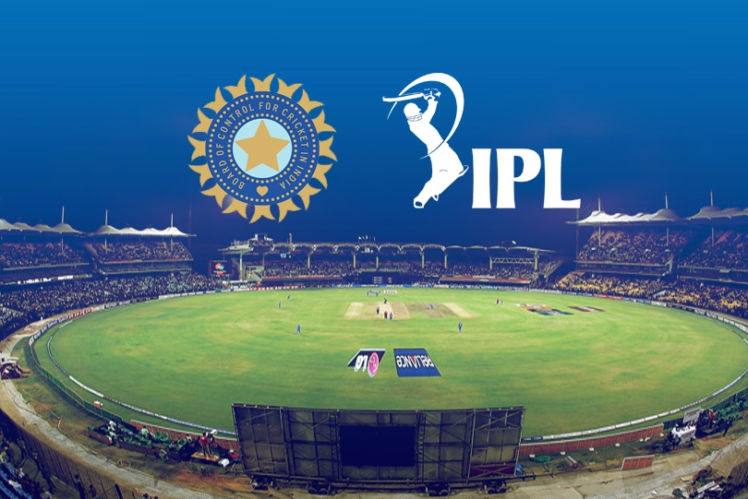
Which season had the most number of matches?

Slide 7
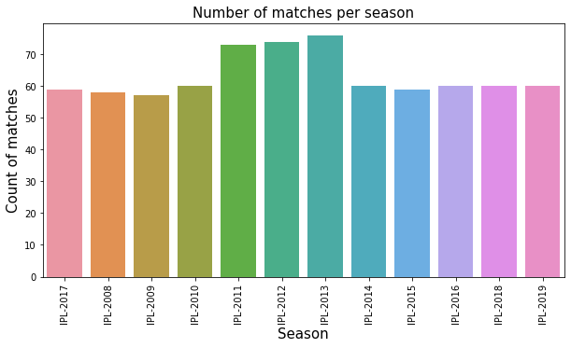
Anything Interesting here??

Slide 8
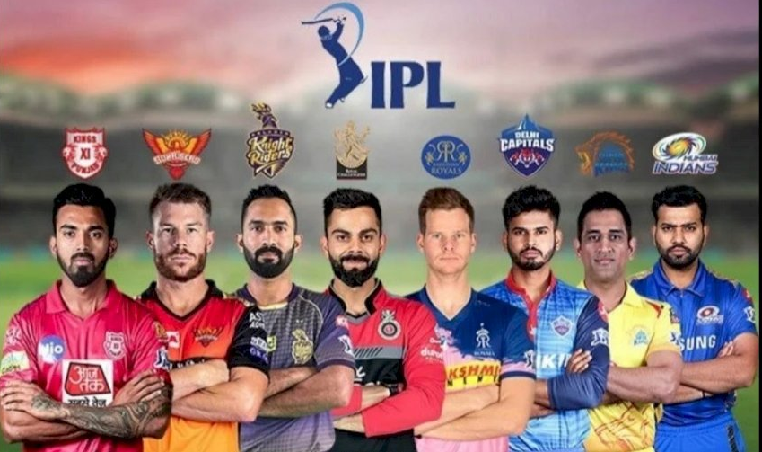
Which team had won maximum number of matches?

Slide 9
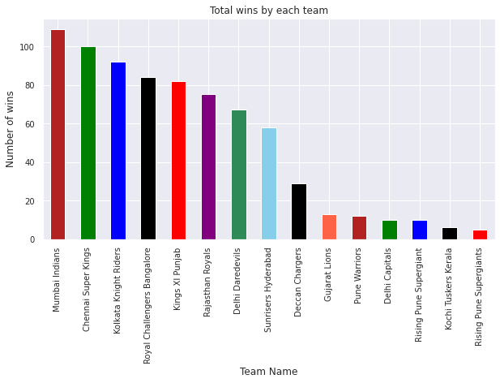
Mumbai, Mumbai !!
No doubts, why MI is still favorite of many!!

Slide 10
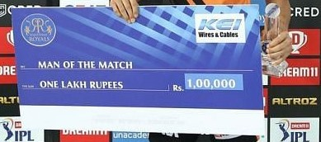
Who do you think lifted the maximum number of “Man of the Match” trophy?

Slide 11
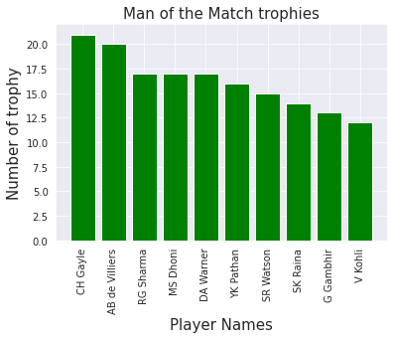
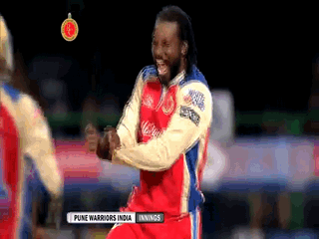
Chris Gayle is a “CHAMPION”

Slide 12
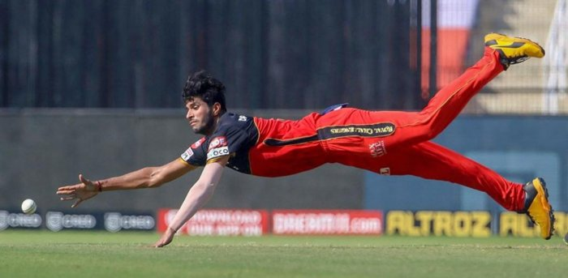
Best fielder throughout the IPL?

Slide 13
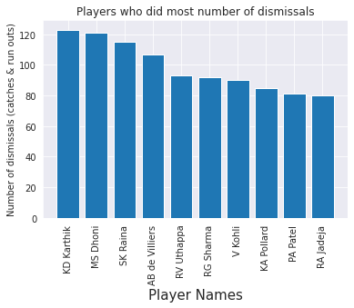
Karthik? No!! MS Dhoni? No!! Then?
Here is something you have to notice:
MS Dhoni and Dinesh Karthik were wicket keepers. So, they had an advantage of getting more number of catches and executing a run out.
So, with the above consideration, Suresh Raina comes out to be the best fielder with the most number of catches and run outs.

Slide 14
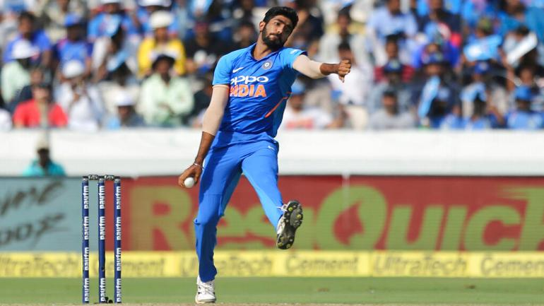
Best economical bowler throughout the IPL?
Notes:
Don’t guess it to be boom boom bumrah :D

Slide 15
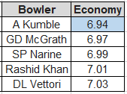
Yes! Jumbo had the best economy rate.
To get to know the best economy rate, we have considered a condition:
The bowler must had bowled at least 300 bowls i.e 50 overs in his career in IPL.
Notes:
Not everything should be shown on graphs and plots :D Have some respects for Pandas :D

Slide 16
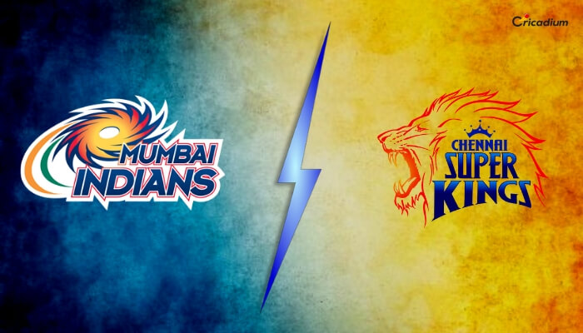
What is the common margin of runs with which any team defeated their opponent?

Slide 17
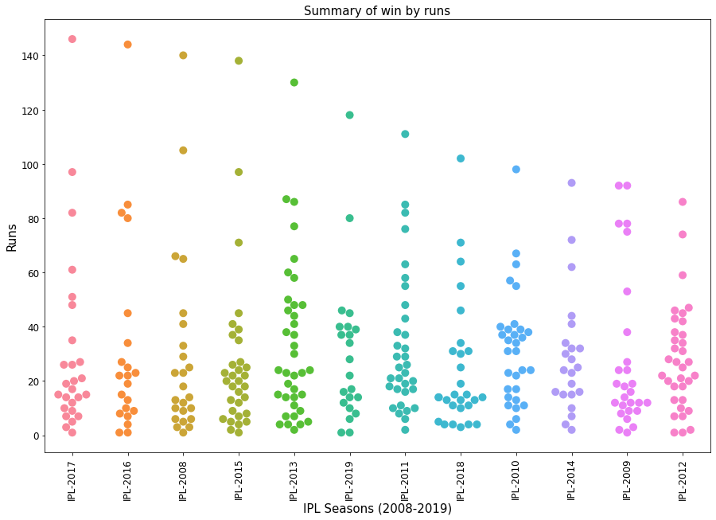
The most common margin of runs was: (10-40)
This plot is explaining too many insights, for instance:
We can easily identify the outliers for each season like in 2017, 146 runs (which was when MI defeated DD).
We can identify the number of close matches each season (like less 5 runs)

Slide 18


Journey of top 5 batsman throughout IPL!!

Slide 19
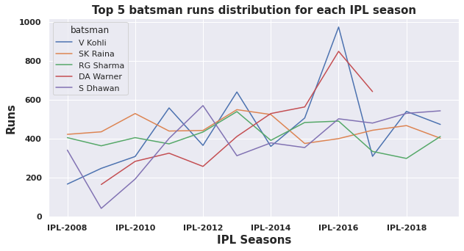
Suresh Raina comes out to be most consistent!!
Though Virat Kohli had highest total runs followed by Suresh Raina.
But, when we see in the graph it is so clear that Suresh Raina had been the most consistent in his form throughout the IPL.

Slide 20
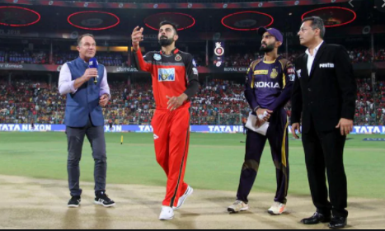
Let’s see how teams performed in home and away matches!!

Slide 21
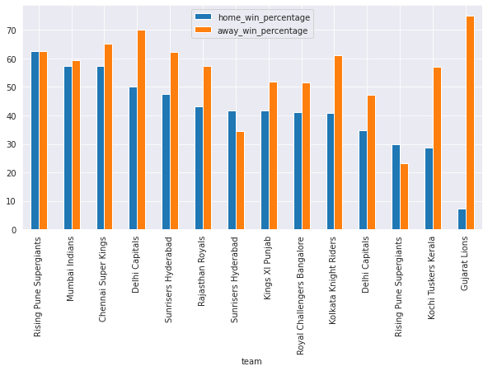
Looks like most of the team had won more in away ground rather than home!!
Even though Gujrat Loins have played only two seasons but look how they have dominated their opponent at their home

Slide 22
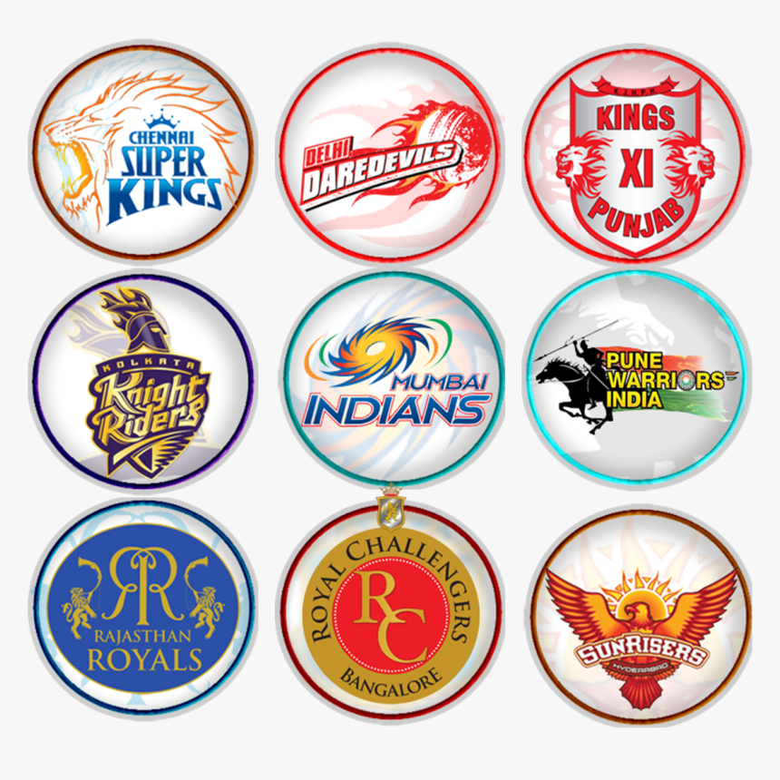
Which team had been the most consistent team throughout the IPL?

Slide 23
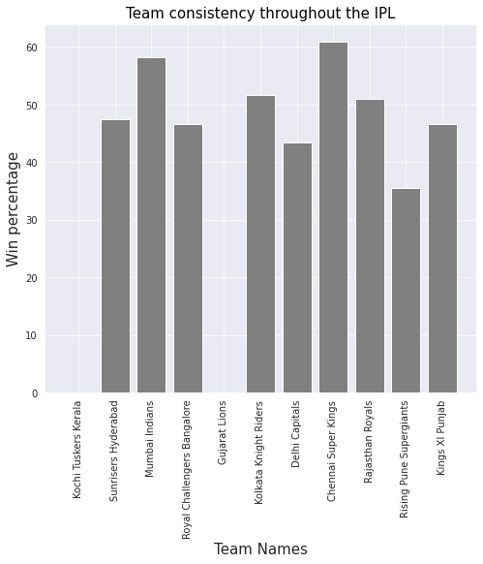
It’s tough one, right? MI or CSK?
Comes out to be CSK!!
Notes:
Considering the win percentage of teams along with the condition that team must have played minimum of 30 matches in IPL.

Slide 24

Let’s see some cool insight’s around orange cap !!!

Slide 25
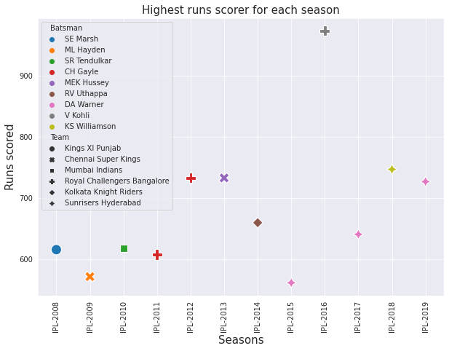
Sunrisers Hyderabad : Risers will “RISE and SHINE”
This plot also shows us the relation between Team and Player for particular season.
This plot also shows us that there is one player who have scored more than 900 runs in particular season

Slide 26
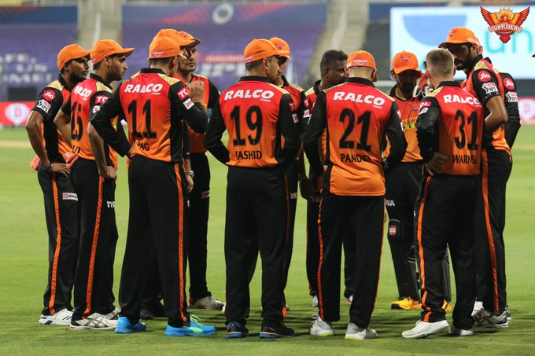
Let’s explore how team build their innings

Slide 27
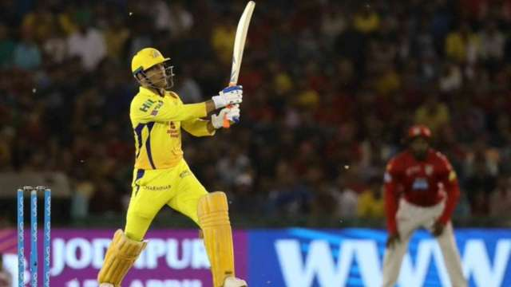
Is there anyone who wanted to guess the max runs scored in an over ?

Slide 28
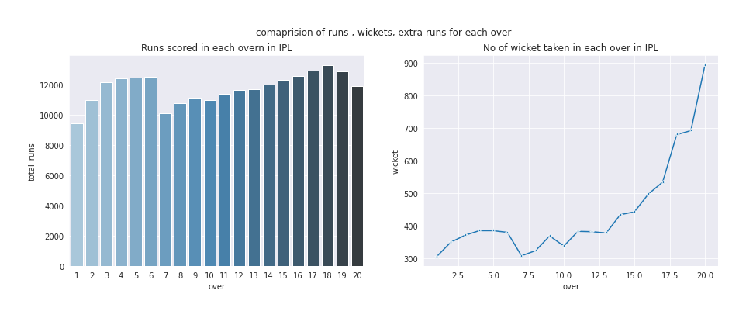
NO!!!! it’s not the last over its 18th over of inning
When batsman goes to score runs the chances of getting out also increases that is clearly visible in second plot.

Slide 29
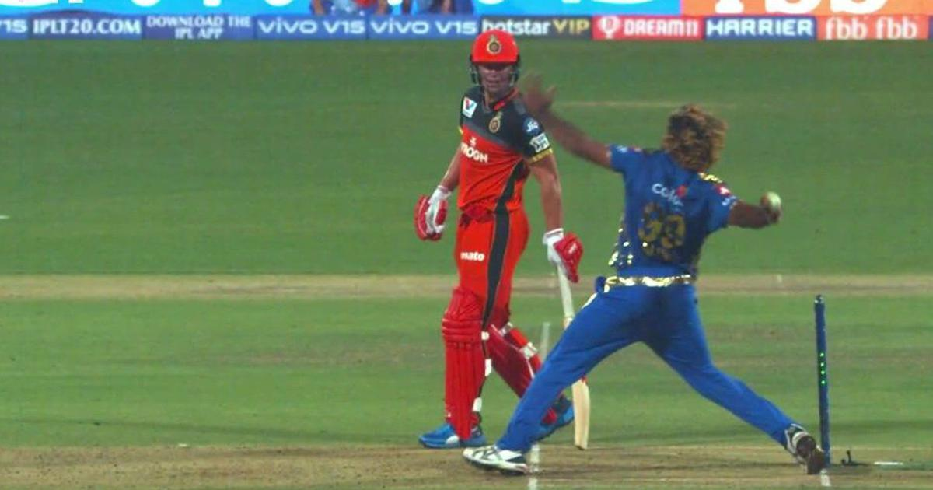
Let’s see how extra runs varies with over

Slide 30
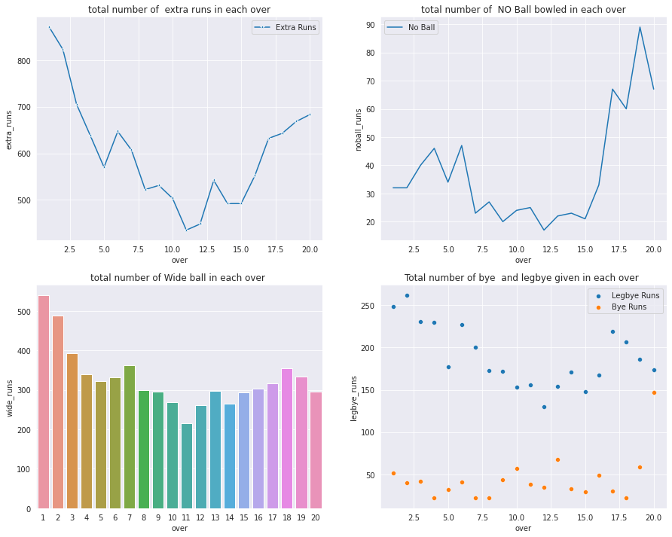
Team gave more extra runs in the start of inning
Major portion of extra runs is due to wide balls and leg bye
Most of the no ball are bowled at the end of innings

Slide 31
Challenges
Difficult to chooses best question from dataset as there were many question that can be addressed
Data set was detailed need lot of data manipulation to reach to any particular conclusion

Slide 32
Conclusion
CSK is the most Consistent team throughout the IPL.
Suresh Raina is consistent player with bat and is one of the best fielder in IPL that’s why he is also known as Mr IPL.
We also found that Chris Gayle has most MOM and scored most centuries that’s why he is known as Mr Entertainer.
We also looked at the journeys of Virat Kohli how he has performed in IPL.

Slide 33
Q & A

